Slide 1
QSAR : Quantitative Structure-Activity Relationship QSPR: Quantitative Structure-Property relationship QSTR: Quantitative Structure-Toxicity relationship
Descriptors – properties or features
Physicochemical
Electronic
Steric
Liphophilicity
Hydrogen bonding
Shape
Charge
Polarizability
Can be used to predict the activity of new compound
Can synthesize a molecule according to the required
Property
Difficult to predict descriptor for the desired function
Mathematical relationship between a biological activity of a molecular system (exp. Value)
and its descriptors

Slide 2
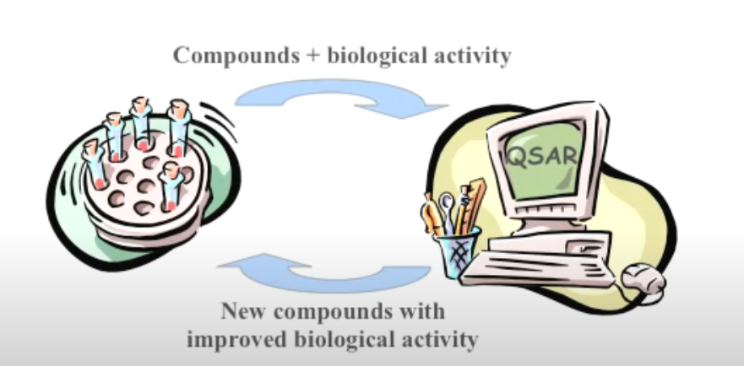
QSAR:
1) Synthesize a compound and evaluate its biological activities (Chloro benzene)
2) Provide the data (physical/chemical properties for simulation-descriptor) and
establish the relationship between properties and performance
3) Compute the data for other substituents depending the property of functional groups.
4) Synthesize those compounds that has the probability of exhibiting higher performance
5) SAVE MONEY AND TIME
OLD METHOD: Synthesize 100 compounds and test biological activity for each
COMPUTATIONAL METHOD: Select 10 compounds that shows higher value from
computational method and reiterate the experiments only with these compounds
and select the best.

Slide 3
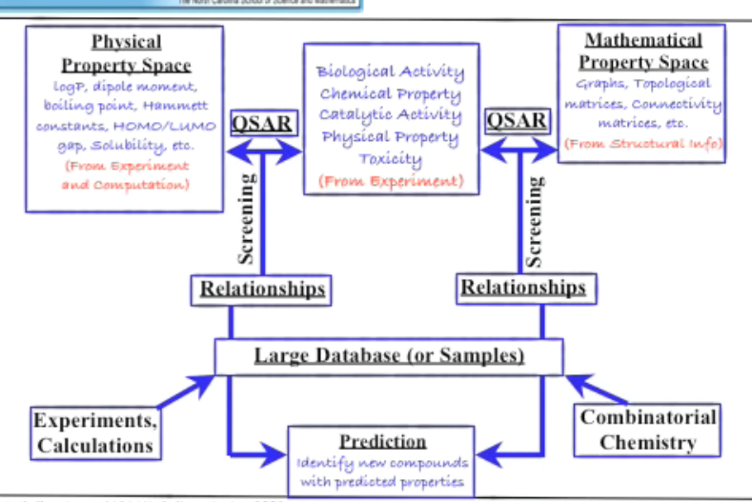

Slide 4
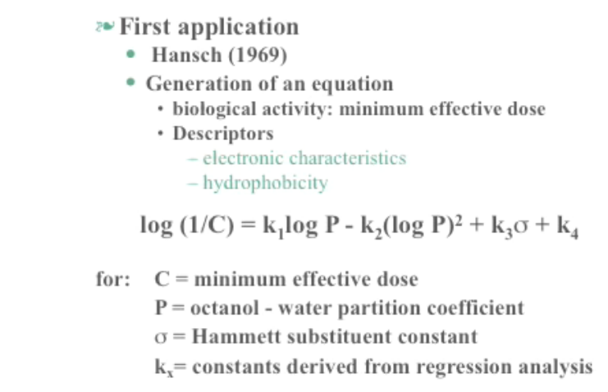

Slide 5
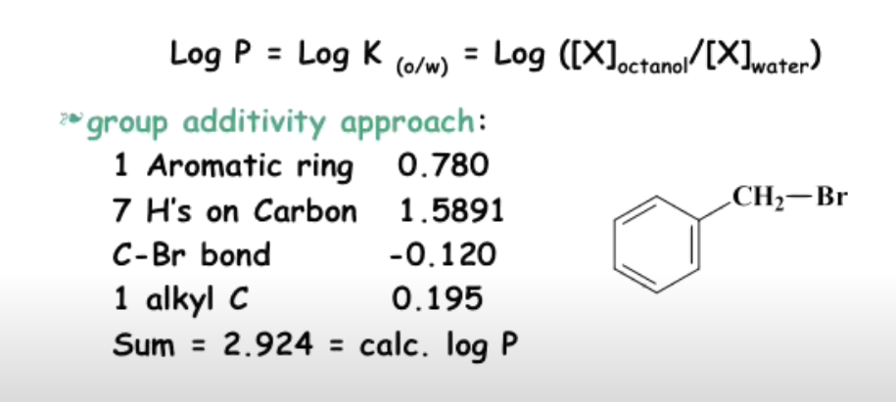

Slide 6
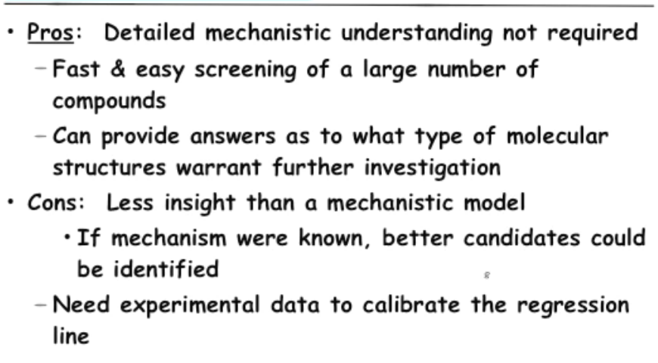

Slide 7
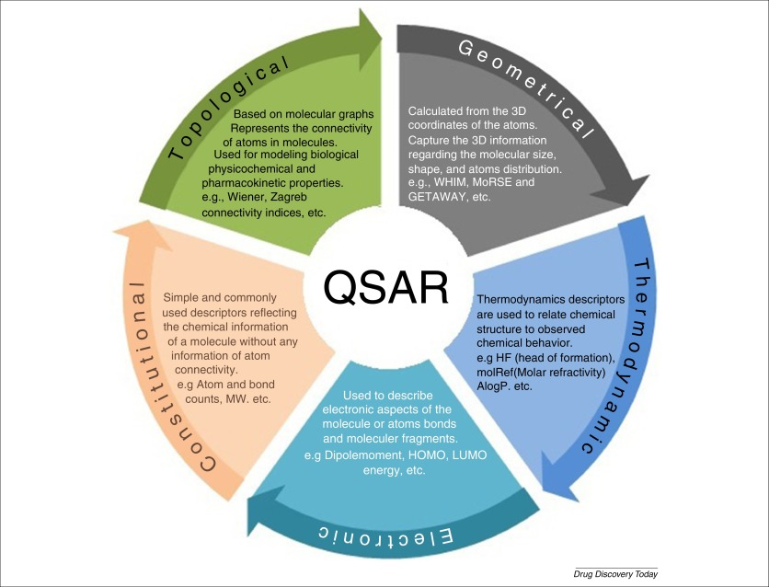

Slide 8
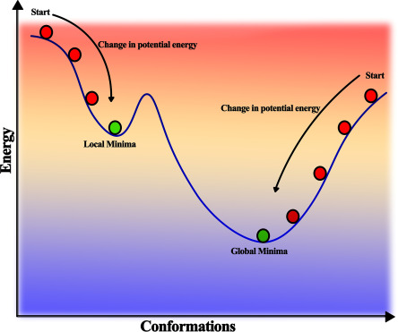
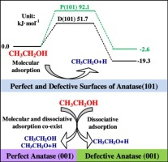
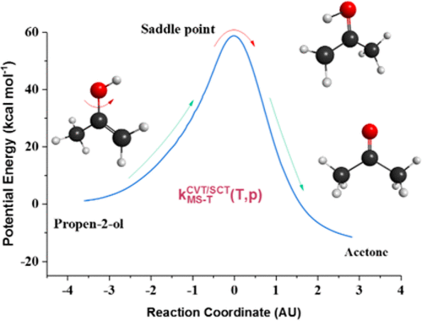
Geometry Optimization
1) Provide the details of bond length,
bond angle, stearic hindrance, molecular interactions
2) Obtain the various conformations
(geometry of the molecule)
3) Computed Gibbs free energy values are obtained.
4) The lowest is chosen as stabilized conformation.

Slide 9
Cost and Efficiency
Efficiency: Validation of theory and computational modeling/results
Carry out the reaction and monitor the selectivity/yield of the products. In case,
some discrepancy exists to identify the products, the computational method can be used to
identify it (isomers).
(2) Provide the descriptors for the system and calculate the formation energies of products.
Accordingly, design the experiments/reaction conditions to yield less amount of byproducts.
(3) If the byproducts are toxic in nature, then alternative substrate/substituents should be
chosen from the computational system without altering the reaction pathways.
COST:
CONSTANT COST: Execution time independent of descriptors.
(small molecules/simple calculations)
LOGARITHMIC COST: Execution time is dependent on descriptors.
(Complex molecules/Calculations)

